Slide 1
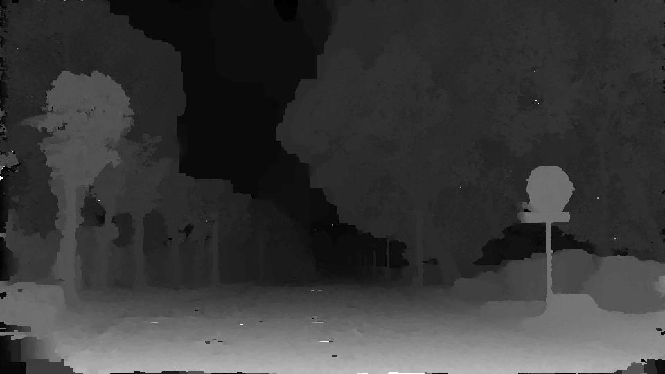
Advanced Error Recovery in Depth from Video
Nie Hongtuo
A0224712N
An EE5731 assignment.

Slide 2
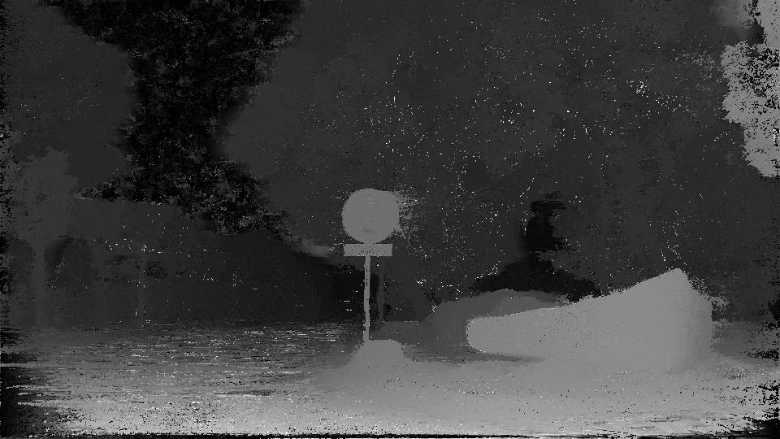
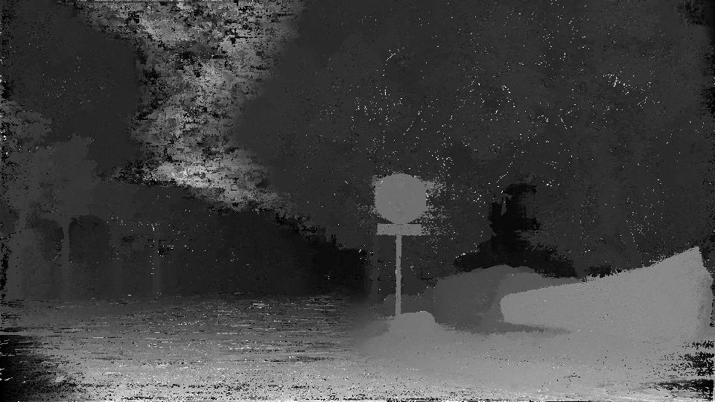
This is a GOOD disparity map:
This is a BAD disparity map:
(Note the part in the sky)
The inconsistency comes from errors during pixel-wise disparity estimation, errors in camera matrices and so on.

Slide 3
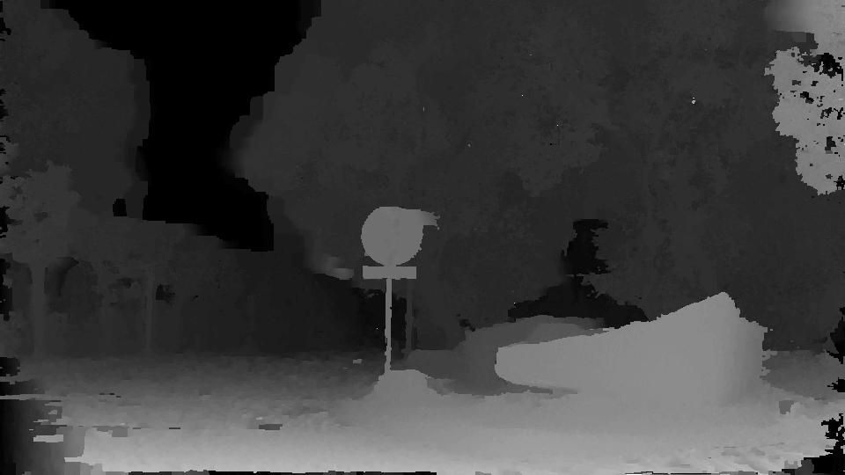
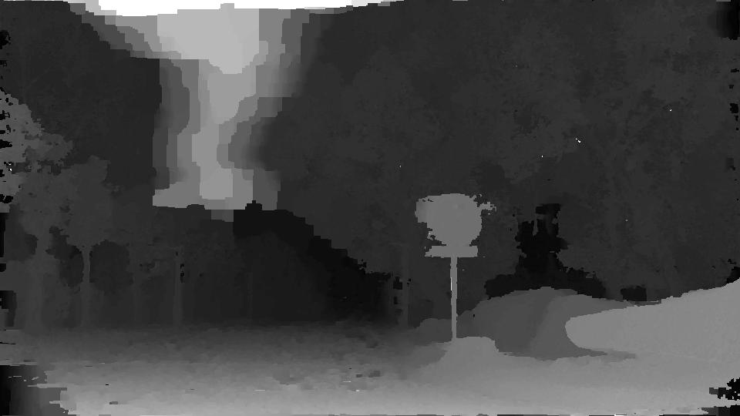
Initialization
Good disparity map after initialization 👆
Bad disparity map after initialization 👇
-- EW! That ruined my depth map!
Initialization

Slide 4
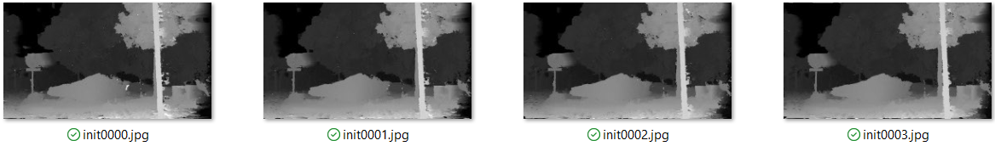
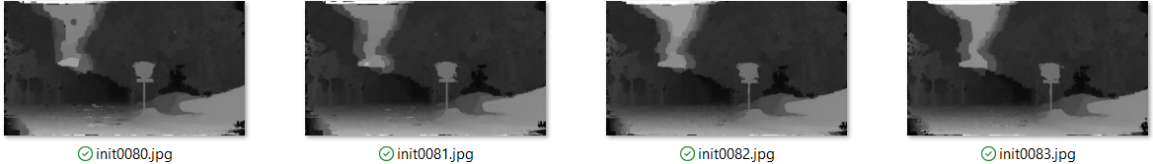
There are 3 types of error in initialized depth map:
The error exist in many continuous frames
The patches are very large
Both A and B
……
……
……
……
In this case, image 70~90 have big error patch in the sky.

Slide 5
Due to limited neighbors (30~40), optimization can only carry out on several images. It’s very possible that the neighbors of a “bad” image are also “bad”. Using the information from wrongly initialized images is not good for bundle optimization.
If we can run many iterations, we can still get a good result, since good images can correct their neighbors. Of course, we need a faster way to optimize.
……
……
……
……
50 Good …… 40 Bad …… 50 Good
……
……
……
……
55 Good …… 30 Bad …… 55 Good
60 Good …… 20 Bad …… 60 Good
65 Good …… 10 Bad …… 65 Good
……
Although I used Parallel Computing Tools in MATLAB, I still need 2 mins to optimize a frame.
We can’t wait for that many iterations!

Slide 6
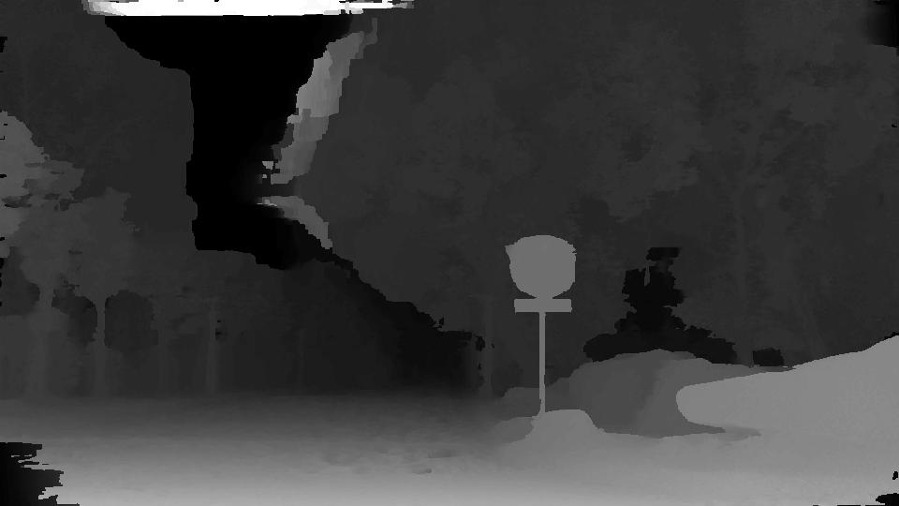
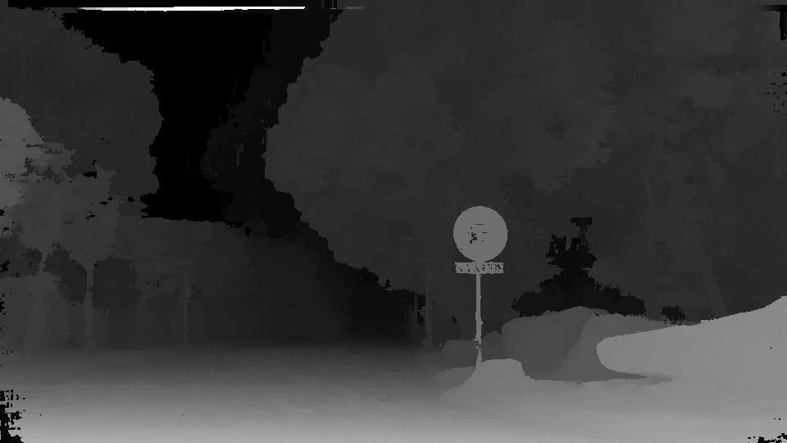
Error Recovery - Plan 1: Random Neighbor Selection
Instead of using adjacent neighbors, I randomly pick the images in bundle optimization. Let’s see how it works:
Left: 1 iteration using adjacent neighbors.
Right: 1 iteration using random neighbors.
Most errors are cancelled in 1 iteration!

Slide 7
Error Recovery - Plan 1: Random Neighbor Selection
Instead of using adjacent neighbors, I randomly pick the images in bundle optimization. Let’s see how it works:
Although Random Neighbor Selection can alleviate continuous initialization error, it has several drawbacks:
It is based on random selection, so the stability is not guaranteed.
We hope the number of neighbors on left and right are balanced.
We still need to select as many neighbors as before, making the computation time-consuming.
Last but the most important: we might still select “bad” images as our neighbors!
The frames in the beginning and the end do not have enough neighbors. The imbalance on number of neighbors will lead to difference in image quality.
How can we use less neighbors for those good images? And use more neighbors for bad images.
Or…We can refine the bad images using the good images!

Slide 8
Error Recovery - Plan 2: Reliable Neighbor Voting
My goal is to construct an initialized image quality indicator, so that we can know which image is more “correct” and “reliable”, which means this can be set as a good reference for others; and which image is more “wrong”, which means it should be fixed.
Here comes the idea of Reliable Neighbor Voting:
When the initialization is done, using the initialized disparity and the camera matrices, we can match each pair of images and see how similar they are. By projecting one image to another, we can find the corresponding coordinates.
Of course, there will be inliers and some outliers that don’t belong to the other image. I did an experiment on the adjacent images. For example, image No. N and N+1 has 99.99% inliers (in this case, since the camera hardly moves between each frame), and image No. N and N+10 has 96.5% inliers.

Slide 9
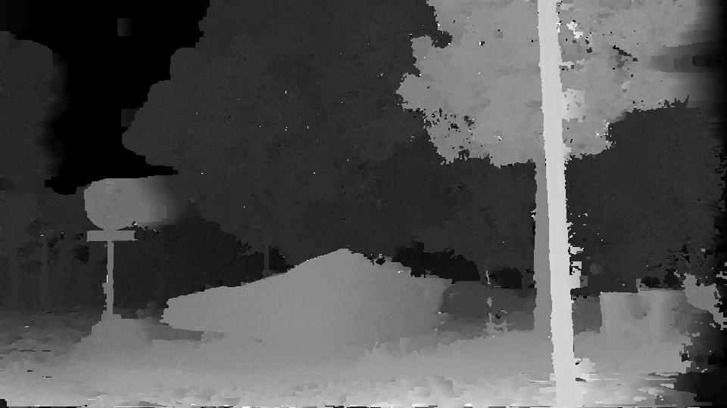
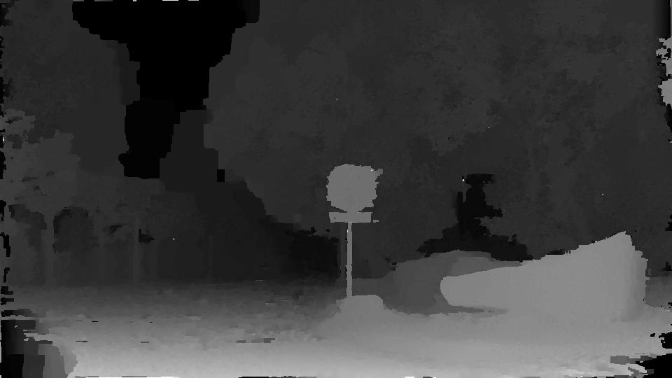
Inliers Outliers

Slide 10
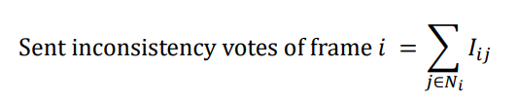
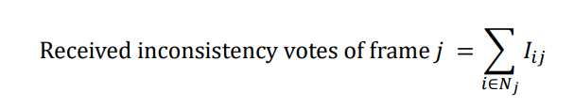
We just focus on the disparity values in the covered part. By computing the sum of the squared Euclidian distance of the corresponding disparity labels in the 2 images, we can get the inconsistency value I_{ij}. This is what I called “votes”.
Let’s first discuss what we expect from the calculation of “votes”. A good image i will give smaller inconsistency value I_{ij} to its neighbor j if they match each other in the covered part. If j has big error patch, then j will get larger vote I_{ij} from i. But also, a bad image i will also give high votes to those that are different from i. Since there are more correct images than the corrupted ones, finally bad images will receive more inconsistency votes. Also, they will send more votes to their neighbors since they themselves are the abnormal ones. Combining these two metrics, we hope we can identify the “good” frames against “bad” frames.

Slide 11
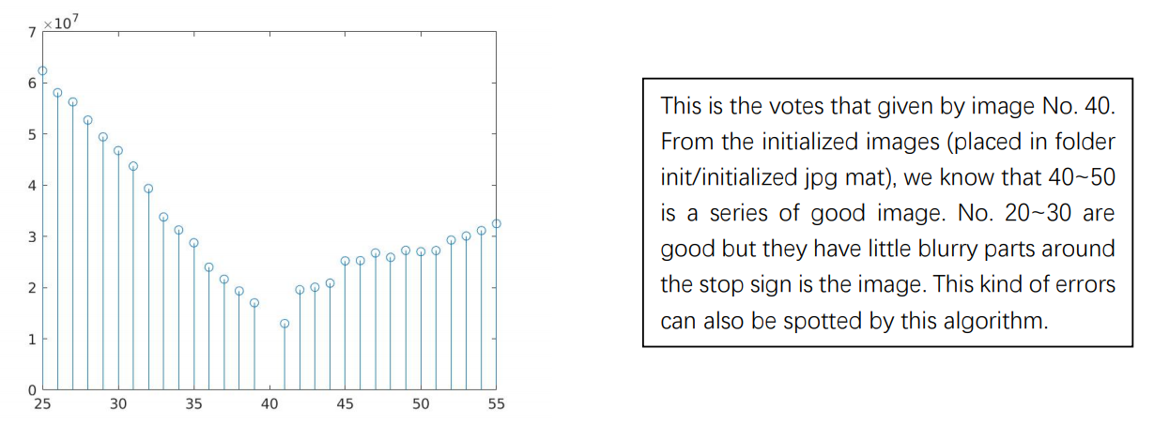
This algorithm is very tractable and fast. It only takes less than 15s for 1 image to vote for its 30 neighbors, even without using parallelism. For each image, the sent votes may look like this:

Slide 12
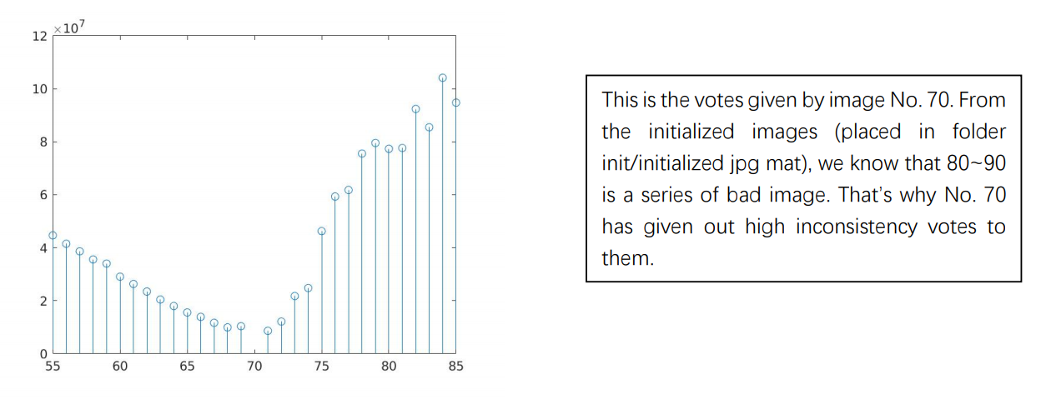
This algorithm is very tractable and fast. It only takes less than 15s for 1 image to vote for its 30 neighbors, even without using parallelism. For each image, the sent votes may look like this:

Slide 13
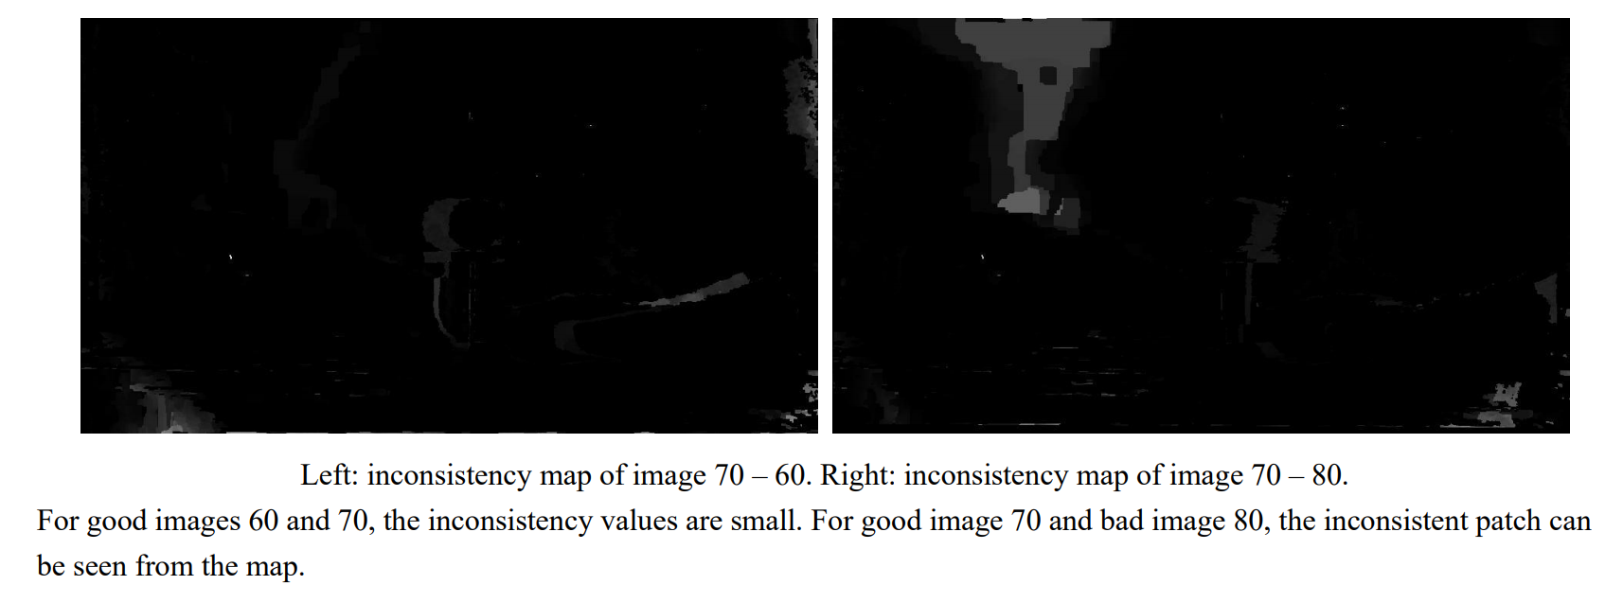
Where are the votes from? We can visualize this by showing the inconsistency map, or inconsistency image.
For each image, the inconsistency image (generated by pixel wise depth label distance) will look like this:

Slide 14
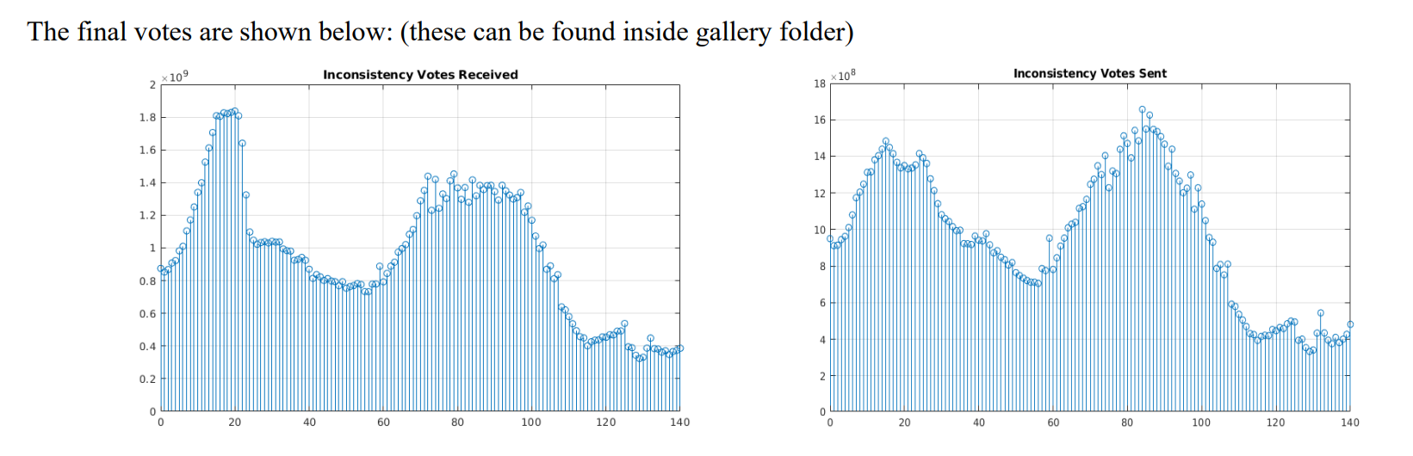

Slide 15
